Slide 1


Sampling and Estimation for Multipurpose Surveys
Yang Cheng¹, Eric Slud², Jeff Bailey¹, and Lu Chen^{1,3}
1. National Agricultural Statistics Service
2. University of Maryland and U.S. Census Bureau
3. National Institute of Statistical Sciences
Tuesday, November 2, 2021
Federal Committee on Statistical Methodology 2021 Research and Policy Conference
Disclaimer: The findings and conclusions of this presentation are those of the authors and should not be construed to represent any official USDA or U.S. Government determination or policy

Slide 2
Outline
Motivation
Multivariate Probability Proportional to Size (MPPS) Sampling
Estimates and variance estimators
Data simulation
Conclusion

Slide 3
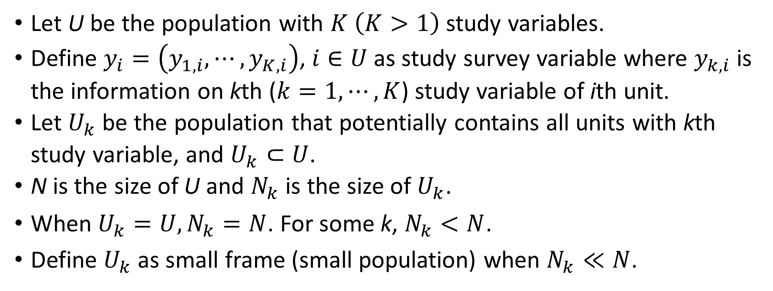
Notation
Let U be the population with $K \left(K>1\right)$ study variables.
Define $y_{i}=\left(y_{1,i},⋯,y_{K,i}\right)$, $i∈U$ as study survey variable where $y_{k,i}$ is the information on kth ($k=1,⋯,K$) study variable of ith unit.
Let $U_{k}$ be the population that potentially contains all units with kth study variable, and $U_{k}⊂U$.
N is the size of U and $N_{k}$ is the size of $U_{k}$.
When $U_{k}=U, N_{k}=N$. For some k, $N_{k}<N$.
Define $U_{k}$as small frame (small population) when $N_{k}≪N$.

Slide 4
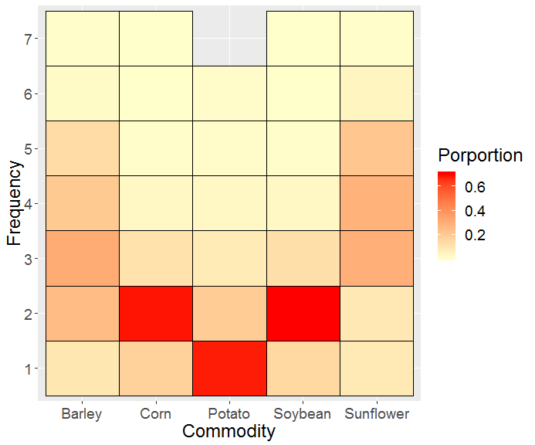
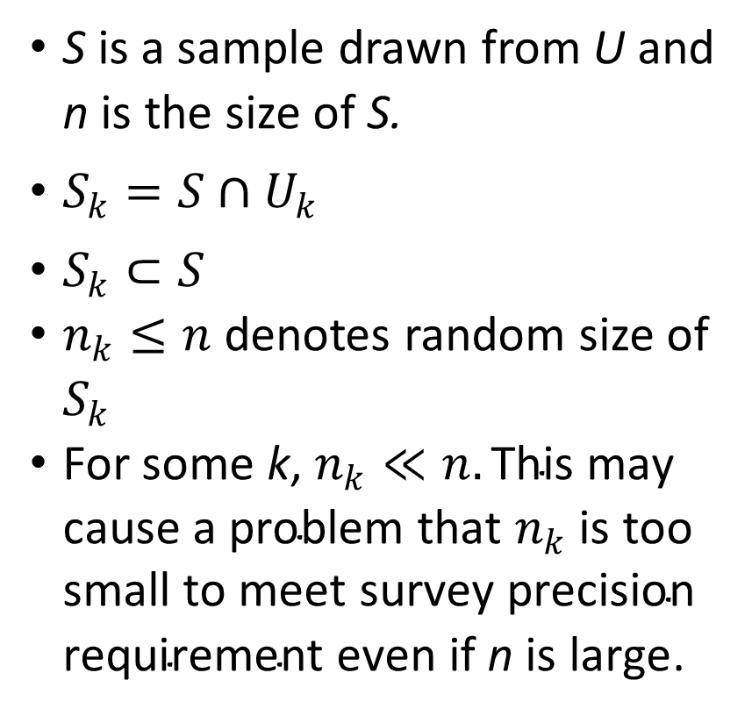
Motivation on samples for multi-commodity farms
S is a sample drawn from U and n is the size of S.
$S_{k}=S∩U_{k}$
$S_{k}⊂S$
$n_{k}≤n$denotes random size of $S_{k}$
For some k, $n_{k}≪n.\text{T}\text{his} \text{may} \text{cause} \text{a} \text{problem} \text{that} n_{k} \text{is} \text{too} \text{small} \text{to} \text{meet} \text{survey} \text{precision} \text{requirement} \text{even} \text{if} \text{n} \text{is} \text{large}$.

Slide 5
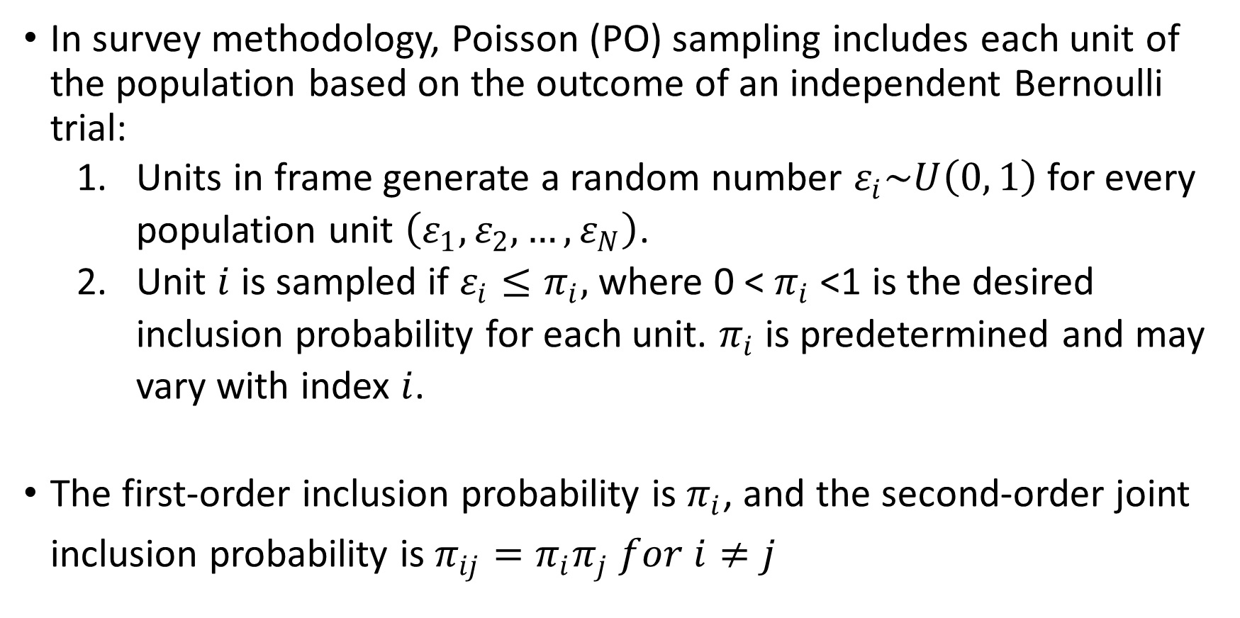
Poisson sampling
In survey methodology, Poisson (PO) sampling includes each unit of the population based on the outcome of an independent Bernoulli trial:
Units in frame generate a random number $ε_{i}\sim U\left(0, 1\right)$for every population unit $\left(ε_{1},ε_{2},…,ε_{N}\right)$.
Unit $i$ is sampled if $ε_{i}≤π_{i},$where 0 < $π_{i}$ <1 is the desired inclusion probability for each unit. $π_{i}$ is predetermined and may vary with index $i$.
The first-order inclusion probability is $π_{i}$, and the second-order joint inclusion probability is $π_{ij}=π_{i}π_{j} for i≠j$

Slide 6
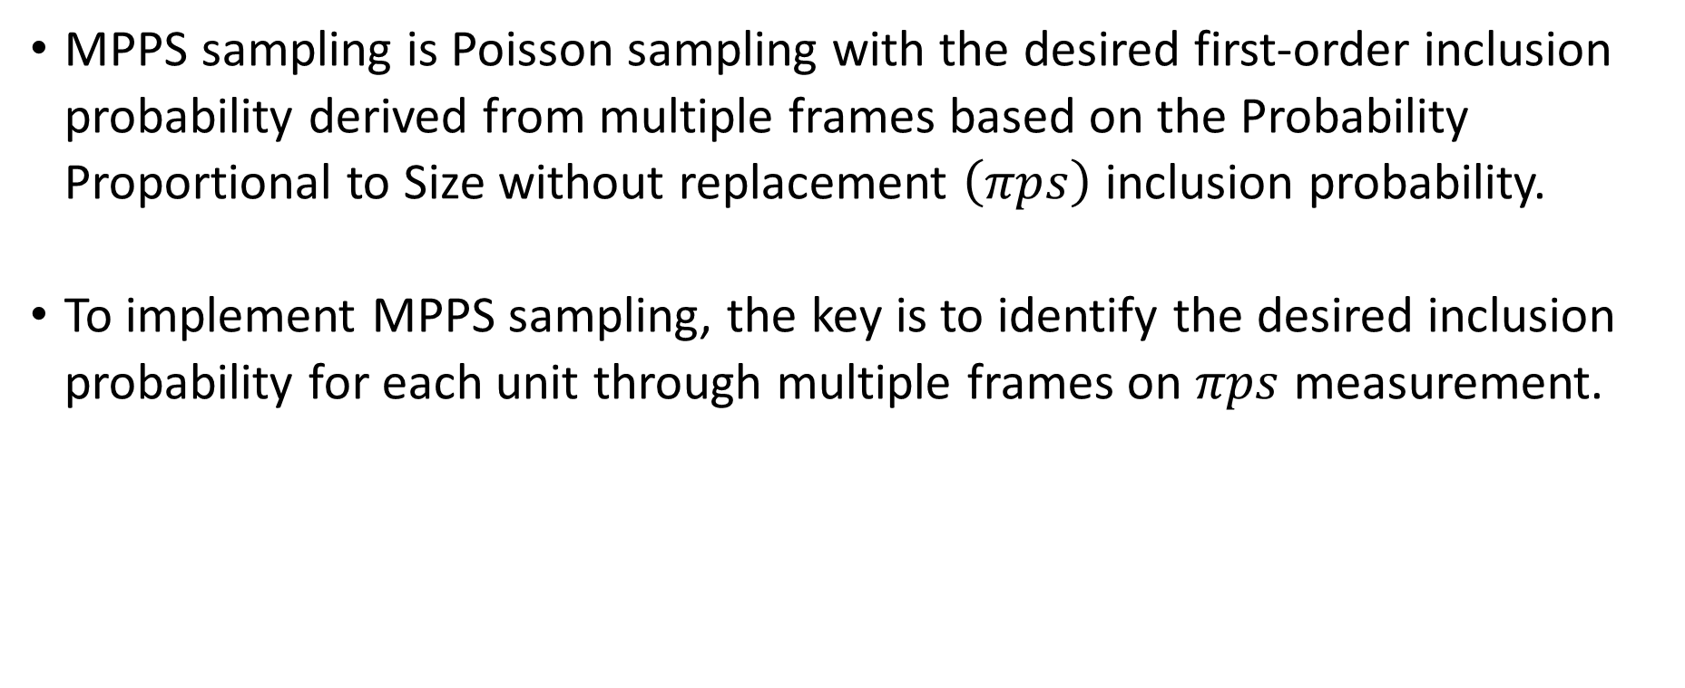
MPPS sampling
MPPS sampling is Poisson sampling with the desired first-order inclusion probability derived from multiple frames based on the Probability Proportional to Size without replacement $\left(πps\right)$ inclusion probability.
To implement MPPS sampling, the key is to identify the desired inclusion probability for each unit through multiple frames on $πps$ measurement.

Slide 7
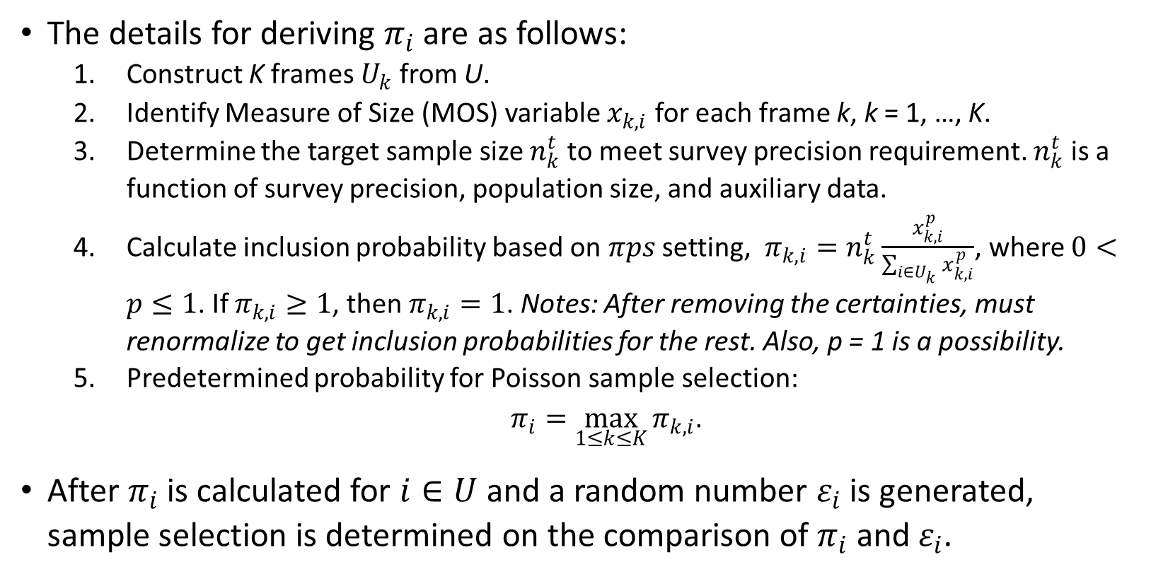
MPPS sampling (cont.)
The details for deriving $π_{i}$ are as follows:
Construct K frames $U_{k}$ from U.
Identify Measure of Size (MOS) variable $x_{k,i}$ for each frame k, k = 1, …, K.
Determine the target sample size $n_{k}^{t}$ to meet survey precision requirement. $n_{k}^{t}$ is a function of survey precision, population size, and auxiliary data.
Calculate inclusion probability based on 𝜋𝑝𝑠 setting, $π_{k,i}=n_{k}^{t}\frac{x_{k,i}^{p}}{\sum_{i∈U_{k}}{x_{k,i}^{p}}}$, where $0<p≤1$. If $π_{k,i}≥1$, then $π_{k,i}=1$. Notes: After removing the certainties, must renormalize to get inclusion probabilities for the rest. Also, p = 1 is a possibility.
Predetermined probability for Poisson sample selection:
$π_{i}=\max_{1≤k≤K}{π_{k,i}}$.
After $π_{i}$ is calculated for $i∈U$ and a random number $ε_{i}$ is generated, sample selection is determined on the comparison of $π_{i}$ and $ε_{i}$.

Slide 8
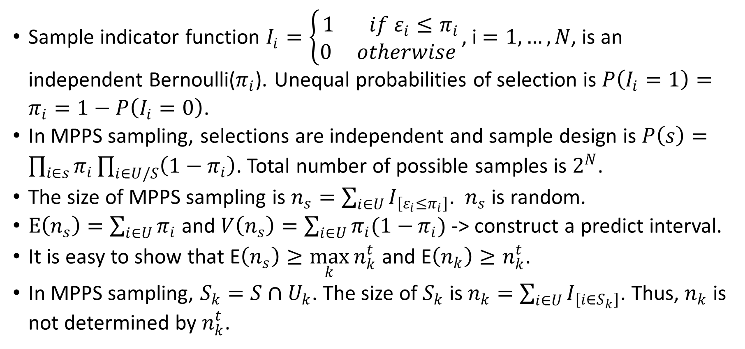
MPPS sampling (cont.)
Sample indicator function $I_{i}=\left\{\begin{aligned}1 if ε_{i}≤π_{i} \\ 0 otherwise \end{aligned}\right.$, i $=1,…,N$, is an independent Bernoulli($π_{i}$). Unequal probabilities of selection is $P\left(I_{i}=1\right)=π_{i}=1−P\left(I_{i}=0\right)$.
In MPPS sampling, selections are independent and sample design is $P\left(s\right)=\prod_{i∈s}{π_{i}}\prod_{i∈U/S}{\left(1−π_{i}\right)}$. Total number of possible samples is $2^{N}$.
The size of MPPS sampling is $n_{s}=\sum_{i∈U}{I_{\left[ε_{i}≤π_{i}\right]}}$. $n_{s}$ is random.
$E\left(n_{s}\right)=\sum_{i∈U}{π_{i}}$ and $V\left(n_{s}\right)=\sum_{i∈U}{π_{i}(1−}π_{i})$-> construct a predict interval.
It is easy to show that E$\left(n_{s}\right)≥\max_{k}{n_{k}^{t}}$ and E$\left(n_{k}\right)≥n_{k}^{t}$.
In MPPS sampling, $S_{k}=S∩U_{k}$. The size of $S_{k}$ is $n_{k}=\sum_{i∈U}{I_{\left[i∈S_{k}\right]}}$. Thus, $n_{k}$ is not determined by $n_{k}^{t}$.

Slide 9
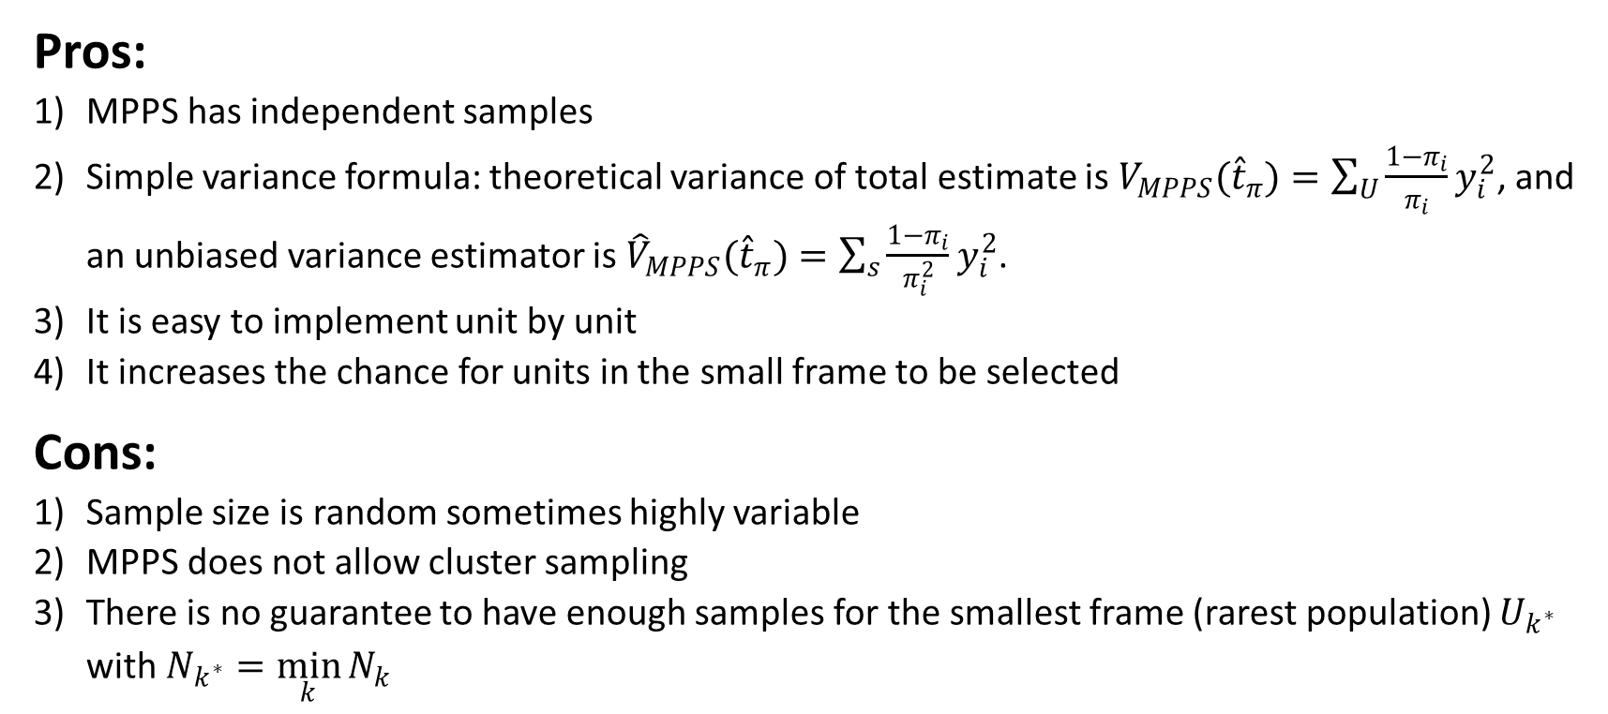
Pros & cons of MPPS sampling
Pros:
MPPS has independent samples
Simple variance formula: theoretical variance of total estimate is ${V_{MPPS}(\hat{t}}_{π})=\sum_{U}{\frac{1−π_{i}}{π_{i}}}y_{i}^{2}$, and an unbiased variance estimator is ${{\hat{V}}_{MPPS}(\hat{t}}_{π})=\sum_{s}{\frac{1−π_{i}}{π_{i}^{2}}}y_{i}^{2}$.
It is easy to implement unit by unit
It increases the chance for units in the small frame to be selected
Cons:
Sample size is random sometimes highly variable
MPPS does not allow cluster sampling
There is no guarantee to have enough samples for the smallest frame (rarest population) $U_{k^{∗}}$ with $N_{k^{∗}}=\min_{k}{N_{k}}$

Slide 10
Alternative approaches
This type of special multiple-purposes survey is a difficult problem. Other approaches can be explored as follows:
Multiple frames
Multivariate stratification method
Prioritized stratification method
Two-phase sampling design

Slide 11
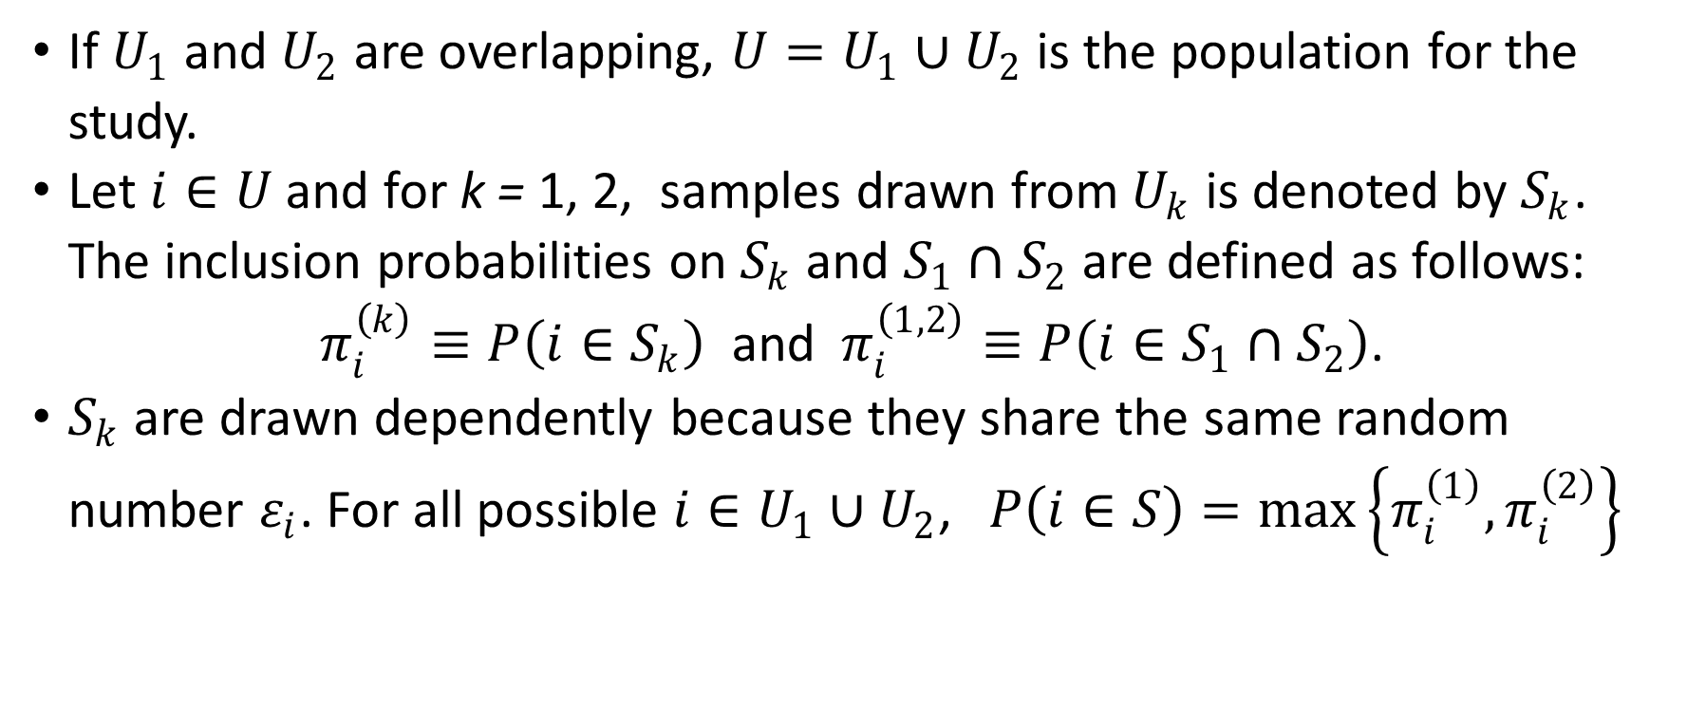
Inclusion Probabilities in a Dual-Frames Setting
If $U_{1}$ and $U_{2}$ are overlapping, $U=U_{1}∪U_{2}$ is the population for the study.
Let $i∈U$ and for k = 1, 2, samples drawn from $U_{k}$ is denoted by $S_{k}$. The inclusion probabilities on $S_{k}$ and $S_{1}∩S_{2}$ are defined as follows:
$π_{i}^{\left(k\right)}≡P\left(i∈S_{k}\right)$ and $π_{i}^{\left(1,2\right)}≡P\left(i∈S_{1}∩S_{2}\right)$.
$S_{k}$ are drawn dependently because they share the same random number $ε_{i}$. For all possible $i∈U_{1}∪U_{2}$,$P\left(i∈S\right)=max\left\{π_{i}^{\left(1\right)}, π_{i}^{\left(2\right)}\right\}$

Slide 12
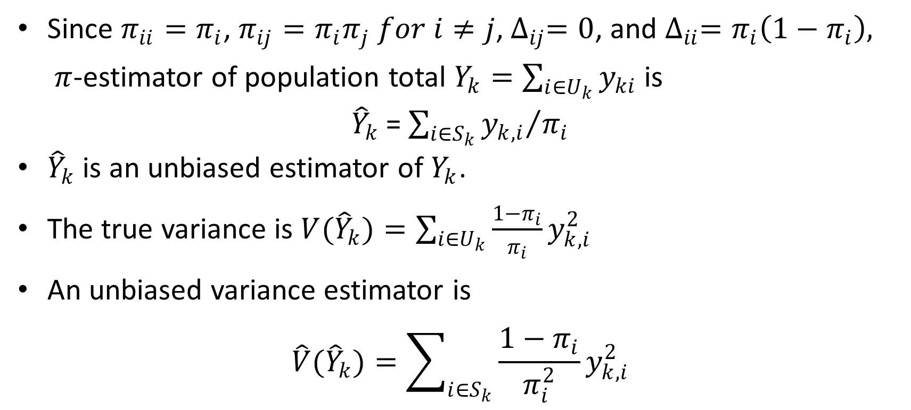
MPPS estimates and variance estimator
Since $π_{ii}=π_{i}$, $π_{ij}=π_{i}π_{j} for i≠j$, $∆_{ij}=0$, and $∆_{ii}=π_{i}\left(1−π_{i}\right), π$-estimator of population total $Y_{k}=\sum_{i∈U_{k}}{y_{ki}}$is
${\hat{Y}}_{k}$= $\sum_{i∈S_{k}}{{y_{k,i}}/{π_{i}}}$
${\hat{Y}}_{k}$ is an unbiased estimator of $Y_{k}$.
The true variance is $V({\hat{Y}}_{k})=\sum_{i∈U_{k}}{\frac{1−π_{i}}{π_{i}}}y_{k,i}^{2}$
An unbiased variance estimator is
$$\hat{V}({\hat{Y}}_{k})=\sum_{i∈S_{k}}{\frac{1−π_{i}}{π_{i}^{2}}}y_{k,i}^{2}$$

Slide 13
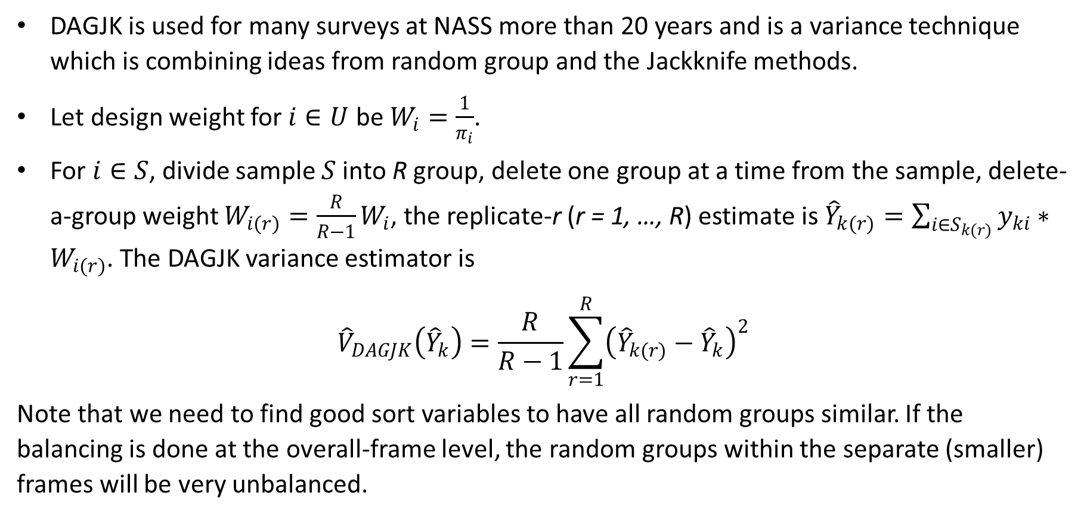
Delete-A-Group Jackknife (DAGJK) method
DAGJK is used for many surveys at NASS more than 20 years and is a variance technique which is combining ideas from random group and the Jackknife methods.
Let design weight for $i∈U$ be $W_{i}=\frac{1}{π_{i}}$.
For $i∈S$, divide sample $S$ into R group, delete one group at a time from the sample, delete-a-group weight $W_{i(r)}=\frac{R}{R−1}W_{i}$, the replicate-r (r = 1, …, R) estimate is ${\hat{Y}}_{k(r)}=\sum_{i∈S_{k(r)}}{y_{ki}}∗W_{i(r)}$. The DAGJK variance estimator is
$${\hat{V}}_{DAGJK}\left({\hat{Y}}_{k}\right)=\frac{R}{R−1}\sum_{r=1}^{R}{{\left({\hat{Y}}_{k(r)}−{\hat{Y}}_{k}\right)}^{2}}$$
Note that we need to find good sort variables to have all random groups similar. If the balancing is done at the overall-frame level, the random groups within the separate (smaller) frames will be very unbalanced.

Slide 14
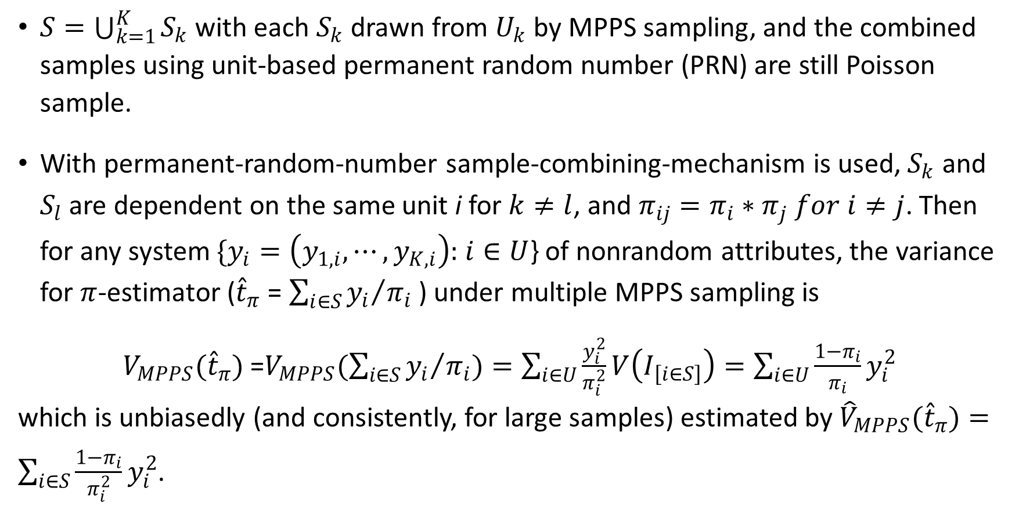
Variance for a Multiple-Frames Setting
$S=\bigcup_{k=1}^{K}{S_{k}}$ with each $S_{k}$ drawn from $U_{k}$ by MPPS sampling, and the combined samples using unit-based permanent random number (PRN) are still Poisson sample.
With permanent-random-number sample-combining-mechanism is used,$S_{k}$ and $S_{l}$are dependent on the same unit i for $k≠l$, and $π_{ij}=π_{i}∗π_{j} for i≠j$. Then for any system $\{y_{i}=\left(y_{1,i},⋯,y_{K,i}\right):$ $i∈U$} of nonrandom attributes, the variance for $π$-estimator (${\hat{t}}_{π}$ = $\sum_{i∈S}{{y_{i}}/{π_{i}}}$) under multiple MPPS sampling is
${V_{MPPS}(\hat{t}}_{π})$=$V_{MPPS}(\sum_{i∈S}{{y_{i}}/{π_{i}}})=\sum_{i∈U}{\frac{y_{i}^{2}}{π_{i}^{2}}}V\left(I_{\left[i∈S\right]}\right)=\sum_{i∈U}{\frac{1−π_{i}}{π_{i}}}y_{i}^{2}$
which is unbiasedly (and consistently, for large samples) estimated by ${{\hat{V}}_{MPPS}(\hat{t}}_{π})=\sum_{i∈S}{\frac{1−π_{i}}{π_{i}^{2}}}y_{i}^{2}$.

Slide 15
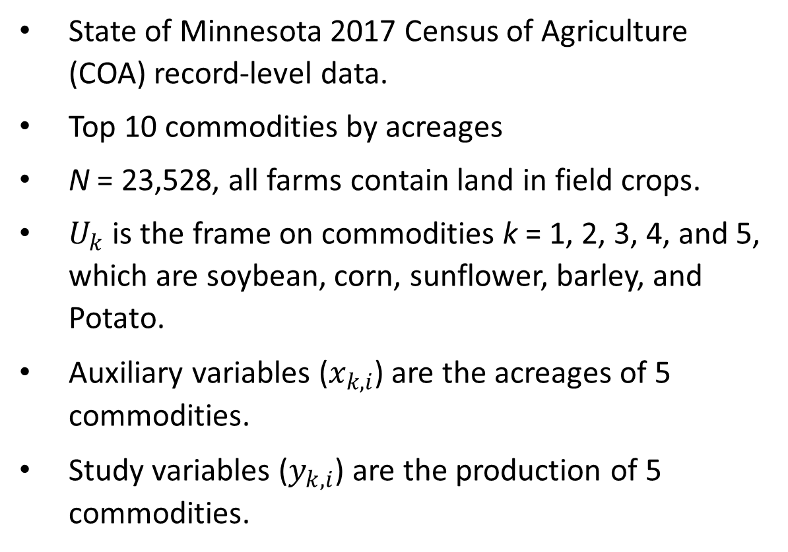
Data simulation study
State of Minnesota 2017 Census of Agriculture (COA) record-level data.
Top 10 commodities by acreages
N = 23,528, all farms contain land in field crops.
$U_{k}$ is the frame on commodities k = 1, 2, 3, 4, and 5, which are soybean, corn, sunflower, barley, and Potato.
Auxiliary variables ($x_{k,i}$) are the acreages of 5 commodities.
Study variables ($y_{k,i}$) are the production of 5 commodities.
 | Harvested Acres | Number of Farms
Soybean | 5,567,246 | 17,924
Corn | 5,049,186 | 17,698
Spring Wheat | 948,038 | 2,753
Potato | 380,907 | 356
Sugarbeet | 361,916 | 856
Dry Bean | 106,557 | 338
Barley | 58,742 | 417
Oat | 56,370 | 1,568
Sunflower | 30,786 | 128
Winter Wheat | 3,925 | 108
Durum Wheat | 1,162 | 12
Sorghum | 252 | 6
Sweet Potato | 187 | 43

Slide 16
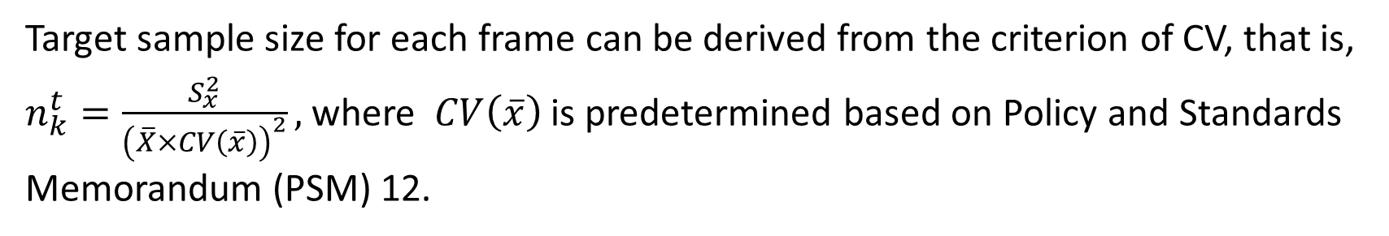
Sample and population information on commodities
Target sample size for each frame can be derived from the criterion of CV, that is, $n_{k}^{t}=\frac{S_{x}^{2}}{{\left(\overline{X}×CV\left(\overline{x}\right)\right)}^{2}},$where $CV\left(\overline{x}\right)$ is predetermined based on Policy and Standards Memorandum (PSM) 12.

Slide 17
Sample size for different commodities
Data simulation for R = 10,000 and for p = 0.75 or p = 1
Sample statistics on different p
Sample distributions on farms for different commodity.
Statistics | n (p=0.75) | n (p=1)
Minimum | 4,139 | 3,938
1st Quartile | 4,288 | 4,072
Median | 4,323 | 4,104
Mean | 4,323 | 4,104
3rd Quartile | 4,357 | 4,135
Maximum | 4,517 | 4,289

Slide 18
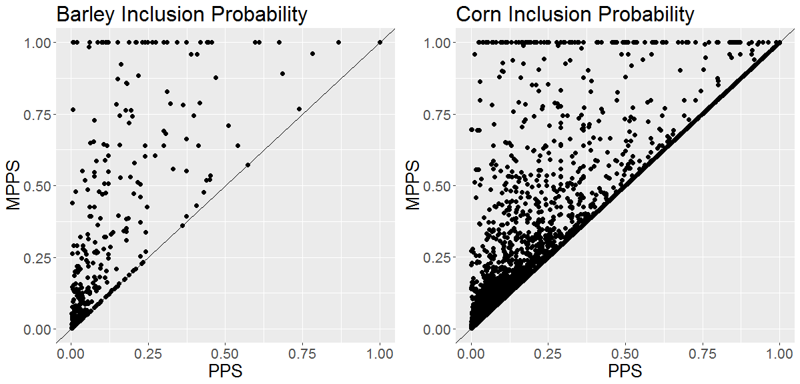
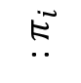
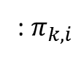
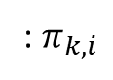
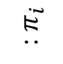
MPPS vs PPS Inclusion Probability
: $π_{i}$
: $π_{i}$
76.02% MPPS > PPS
14.47% MPPS > PPS
: $π_{k,i}$
: $π_{k,i}$

Slide 19
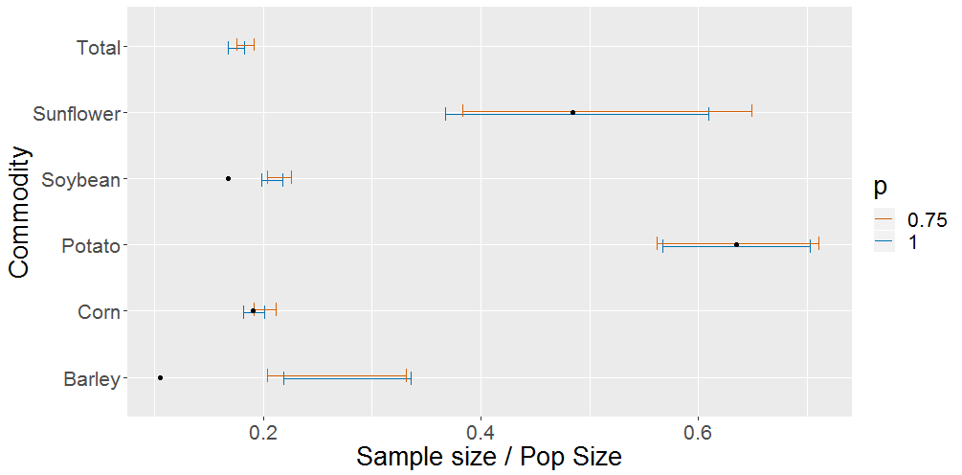
The ranges of the proportions of sample sizes for R=10,000

Slide 20
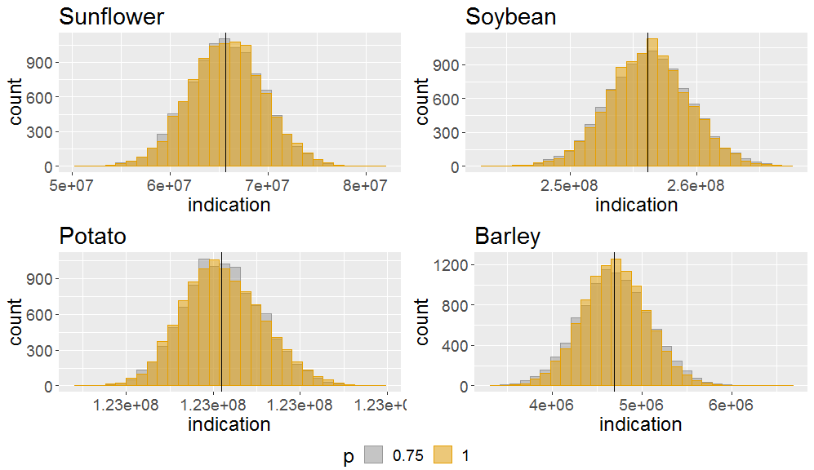

Distribution of point estimates vs true $Y_{k}$, R=10,000

Slide 21
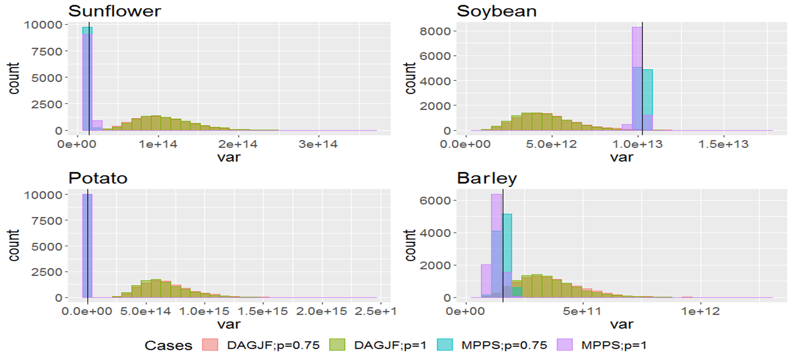
Variance comparison among theoretical, MPPS, and DAGJF

Slide 22
What we learn from this study
MPPS sampling increases inclusion probability and sample for many units, especially for small and middle size populations.
MPPS sampling increases overall sample size. It may increase the cost. Rescaling the inclusion probability in order to reduce the sample size can be considered.
We recommend using the Poisson sampling variance formulas in MPPS setting.
Combining MPPS samples using unit-based PRNs are still Poisson sample.

Slide 23
Thank you for your interest !
Contact information:
yang.cheng@usda.gov

